Slide 1

ENGG404 – Lecture Chapter 3.3: RME #6 PECI (Program Evaluation & Continuous Improvement)
Fundamentals of RM
RM System and Process
Leadership in RM
Incident Investigation
RM Tools & Challenges
RM in Industry
People & Org.
Applications & Perspectives
On Becoming A Leader In Risk Management

Slide 2
Learning Outcomes:
Explain the purpose of the RMS element “Program Evaluation and Continuous Improvement” (PECI)
Explain the significance of the PECI element in a Risk Management System.
Apply the Formal Audit Process
Explain how PDCA relates to PECI (Audits).
Chapter 3.3: RME#6 Program Evaluation and Continuous Improvement
2
Notes:
2

Slide 3
Introduction:
As the name implies, PECI is the element that defines what management must evaluate in their risk management program in order to improve on their program.
Same tenets as PDCA! proactive and continuous improvement.
PECI is essentially an audit of all parts of the risk management program.
(Some modules of the Handbook refer to an audit as a “planned inspection at the organizational level”.)
Chapter 3.3: RME#6 Program Evaluation and Continuous Improvement
3
Notes:
3

Slide 4
The Audit:
The Audit is a best practice.
It finds deficiencies and weaknesses in the risk management system and program – both content and implementation.
Driven by government regulations, industry association policies and standards (whether imposed or adopted), and corporate policies and standards.
There are two types of Audits:
Internal audit i.e. by managers of their own facilities.
External audit: By specially-trained auditors of a “third-party” who examine the manager’s facility.
It tests implementation at the organizational level: to see how well the RM program is effectively implemented. Examples:
MOC Process
Incident Reporting, Analysis, Investigation, and Action
Training
Chapter 3.3: RME#6 Program Evaluation and Continuous Improvement
4
Notes:
4

Slide 5

Why Audit the Organization?
An audit is a test at the organizational level.
The leading question: “Is the audit needed for an organization to be successful?”
The answer is “Yes”, of course. But why?
The audit is needed because the audit tests the effectiveness of the implementation of the risk management system and program at the organizational level: to see how well the RM program is effectively implemented by the people in the organization.
The objective of the effective implementation of an RM Program is to improve safety performance, and reduce losses.
An RM Program may “be good on paper” but it will not deliver results (improved safety performance) if it is not effective implemented. Case study: BP-DWH LI (later in the term)
Chapter 3.3: RME#6 Program Evaluation and Continuous Improvement
5
Notes:
5

Slide 6
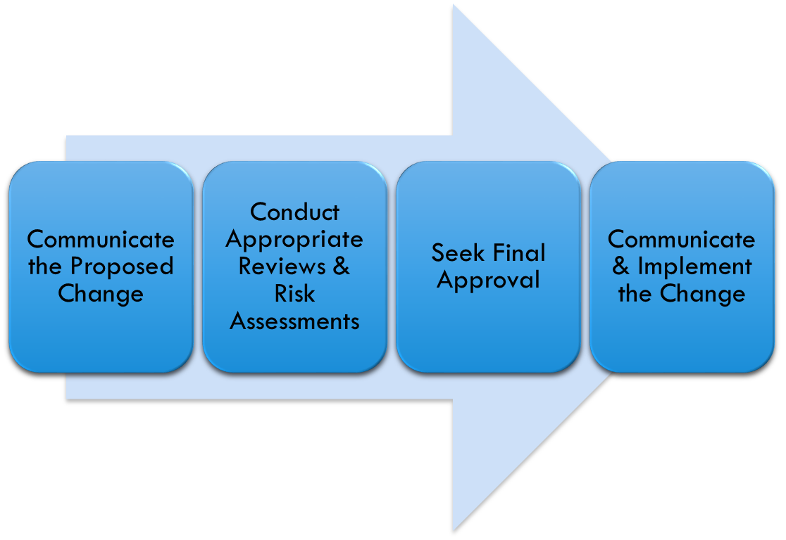
The Audit on the MOC Process:
Recall the Four Critical Steps from the MOC Process:
To check that the MOC Process was working effectively, the Auditor creates the set of questions opposite every requirement listed in the MOC Process!
Chapter 3.3: RME#6 Program Evaluation and Continuous Improvement
6
Notes:
6

Slide 7
The Audit on the MOC Process:
What kinds of questions would you ask about the MOC Process?
These kinds of questions can be asked in an audit:
Were proposed changes communicated?
What kinds of risk assessments were conducted for the scope of change? Appropriate? The right mix of stakeholders and SMEs? Did these result in revisions to the proposed change?
Was final approval granted? What is the evidence that confirms the final approval checked that the MOC process was fully applied for the change?
Was the change communicated prior to implementation? Were documents updated and training conducted prior to implementation? What evidence is there?
Chapter 3.3: RME#6 Program Evaluation and Continuous Improvement
7
Notes:
7

Slide 8
The Audit on the MOC Process:
To answer the questions, the auditor must seek out evidence to check.
A database or dataset of records MUST exist for changes:
proposed and in-progress,
proposed and abandoned,
proposed and implemented changes <- these ones are of most interest!
The records can be the “paper-trail”, virtual or actual!
Select a number of records from the implemented changes.
Check the recorded information in those records opposite the requirements of the MOC Process.
Interview persons who have been a part of the MOC.
Their names should be on the records.
Identify and record any deficiencies
e.g. a step was missed, a person did not receive the required training prior to the person using the implemented change.
Report findings, sometimes with recommendations, to the manager of the facility.
Chapter 3.3: RME#6 Program Evaluation and Continuous Improvement
8
Notes:
8

Slide 9
The Audit on the II-RCA-MA Work Process:
Leading organizations INCLUDE the PECI of the overall process!
Incident Happens
Incident Investigation
Root Cause Analysis
Manage Corrective Actions
Check Process Effectiveness
Chapter 3.3: RME#6 Program Evaluation and Continuous Improvement
9
Notes:
9

Slide 10
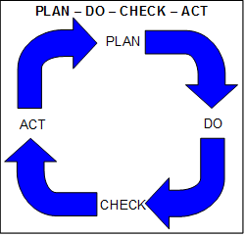
PDCA, PECI, & Leadership in Risk Management
Recall that PDCA is driven by management:
Leaders exhibit commitment by planning audits, doing, and checking, and by acting i.e. holding their people accountable.
ENGG404 Risk Management System and its 11 Elements:
Management Leadership, Commitment and Accountability.
Risk Assessment and Management of Risks.
Community Awareness and Emergency Preparedness.
Management of Change.
Incident Reporting, Investigation, Analysis and Actions.
Program Evaluation and Continuous Improvement.
Design, Construction and Start-up.
Operations and Maintenance.
Employee Competency and Training.
Contractor Competency and Integration.
Operations and Facilities Information and Documentation.
DRIVER
Chapter 3.3: RME#6 Program Evaluation and Continuous Improvement
10
Notes:
10

Slide 11
PDCA, PECI, & Leadership in Risk Management
Recall that PDCA is driven by management:
Leaders exhibit commitment by planning audits, doing, and checking, and by acting i.e. holding their people accountable.
For PECI, leaders CHECK that their risk management program is effective, and when found deficient, actions are taken to correct.
ENGG404 Risk Management System and its 11 Elements:
Management Leadership, Commitment and Accountability.
Risk Assessment and Management of Risks.
Community Awareness and Emergency Preparedness.
Management of Change.
Incident Reporting, Investigation, Analysis and Actions.
Program Evaluation and Continuous Improvement.
Design, Construction and Start-up.
Operations and Maintenance.
Employee Competency and Training.
Contractor Competency and Integration.
Operations and Facilities Information and Documentation.
DRIVER
Chapter 3.3: RME#6 Program Evaluation and Continuous Improvement
11
Notes:
11

Slide 12
PDCA, PECI, & Leadership in Risk Management
Recall that PDCA is driven by management:
Leaders exhibit commitment by planning audits, doing, and checking, and by acting i.e. holding their people accountable.
For PECI, leaders CHECK that their risk management program is effective, and when found deficient, actions are taken to correct.
In fact, leading organizations test ALL elements of their risk management program … even PECI!
ENGG404 Risk Management System and its 11 Elements:
Management Leadership, Commitment and Accountability.
Risk Assessment and Management of Risks.
Community Awareness and Emergency Preparedness.
Management of Change.
Incident Reporting, Investigation, Analysis and Actions.
Program Evaluation and Continuous Improvement.
Design, Construction and Start-up.
Operations and Maintenance.
Employee Competency and Training.
Contractor Competency and Integration.
Operations and Facilities Information and Documentation.
DRIVER
Chapter 3.3: RME#6 Program Evaluation and Continuous Improvement
12
Notes:
12

Slide 13
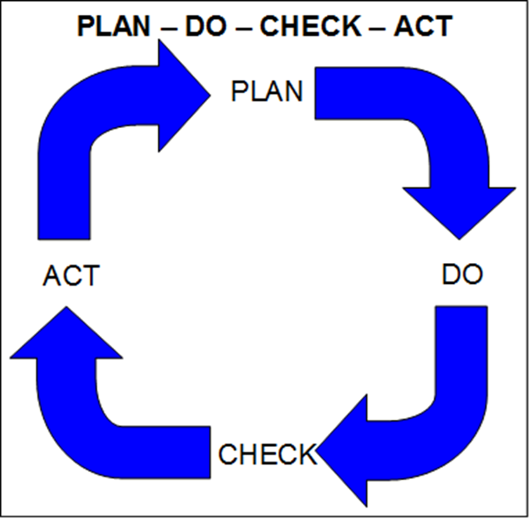
The Connection to the Fundamental Management Process:
Through effective application, management system weaknesses can be discovered, deficiencies addressed: the overall program and thus its performance, are on a continuous cycle of improvement:
RMS El#6: Program Evaluation and Continuous Improvement!
PECI ensures the risk management program is effectively (and robustly) implemented.
Chapter 3.3: RME#6 Program Evaluation and Continuous Improvement
13
Notes:
13

Slide 14
An Industry Risk Management System:
The ExxonMobil OIMS and its 11 Elements:
The similarities to the APEGA Model are readily apparent.
Chapter 3.3: RME#6 Program Evaluation and Continuous Improvement
14
Notes:
14

Slide 15
PDCA as Exercised Through & Driven By Leadership:
The ExxonMobil OIMS and its 11 Elements:
DRIVER
Chapter 3.3: RME#6 Program Evaluation and Continuous Improvement
15
Notes:
15

Slide 16
PDCA to Evaluate the RM Program:
The ExxonMobil OIMS and its 11 Elements:
EVALUATION
(aka PECI)
Chapter 3.3: RME#6 Program Evaluation and Continuous Improvement
16
Notes:
16

Slide 17
Compare Two Risk Management Systems
The ExxonMobil OIMS and its 11 Elements:
DRIVER
EVALUATION
(aka PECI)
The similarities to the APEGA Model are readily apparent.
Chapter 3.3: RME#6 Program Evaluation and Continuous Improvement
17
Notes:
17

Slide 18
Summary:
“Program Evaluation and Continuous Improvement” (PECI) is a form of PDCA on the Risk Management Program as a whole i.e. PECI tests the implementation of how well the RMP is working.
Management is responsible for driving the evaluation and corrections of deficiencies in the Risk Management Program.
The Formal Audit Process – a test of the organization – is the means to implement PECI.
Chapter 3.3: RME#6 Program Evaluation and Continuous Improvement
18
Notes:
18

